Slide 1
E-COMMERCE DATABASE PRESENTATION
Abdirahman Ali

Slide 2
INTRODUCTION
Today, I’ll explain how my e-commerce database was designed, built, and visualized in Tableau. This presentation will cover the following:
Database ERD (Entity-Relationship Diagram) & Relationships
SQL Database Implementation
Queries used to pull from the database using sample data (AI generated for demonstrative purposes).
Tableau visualizations & dashboard results
Conclusion

Slide 3
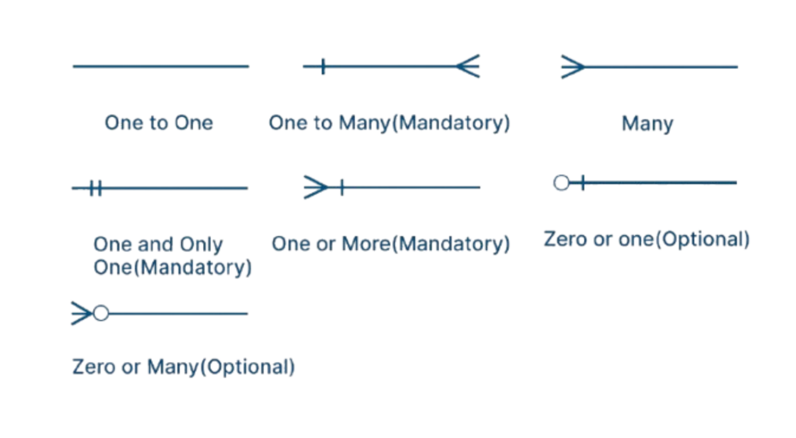
Database ERD (Entity-Relationship Diagram) Terminology
Source: https://creately.com/guides/er-diagram-symbols/

Slide 4
Database ERD (Entity-Relationship Diagram) Terminology
Entity = table
Primary Key = unique row ID
Foreign key = connects tables
Relationship = how tables connect

Slide 5
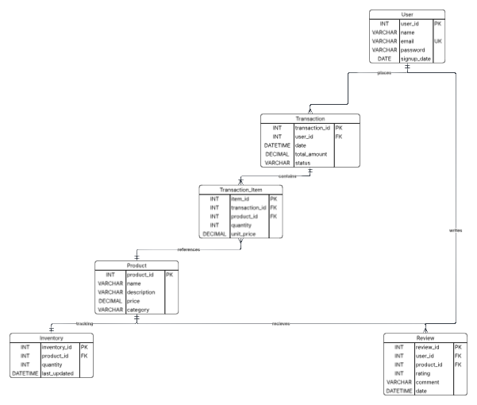
Database ERD (Entity-Relationship Diagram)

Slide 6
Database ERD & Implementation Breakdown
Table | Purpose
User | Stores customer accounts and information
Product | Stores product details
Inventory | Tracks product stock
Transaction | Stores customer orders
Transaction_Item | Stores products inside each order
Review | Stores product reviews
With the ERD created:
It is defined that users can place transactions.
Transactions contain transaction items.
Products have inventory and reviews.
With the Implementation of the database:

Slide 7
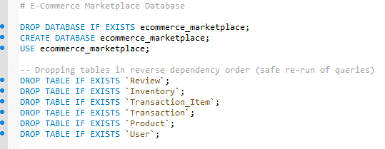
SQL Database Implementation

Slide 8
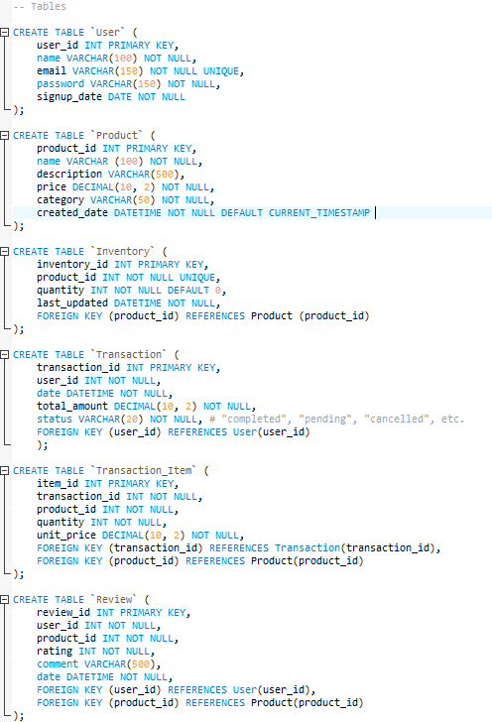
SQL Database Implementation

Slide 9
Queries Used to Generate Information
Given that this is a demonstration, AI was used to generate majority of the data insertion to the database to create visualizations in Tableau. But before I could do that, the following queries were needed.

Slide 10
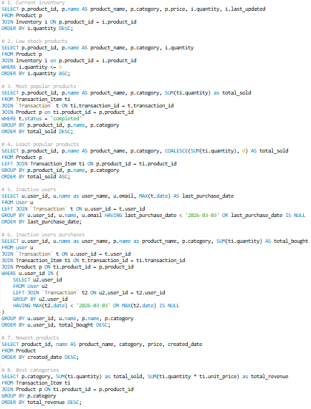
Queries

Slide 11
Dashboard Questions
Current inventory
Low stock products
Most popular products
Least popular products
Inactive users
Purchases by inactive users
Newest product
Best performing categories

Slide 12
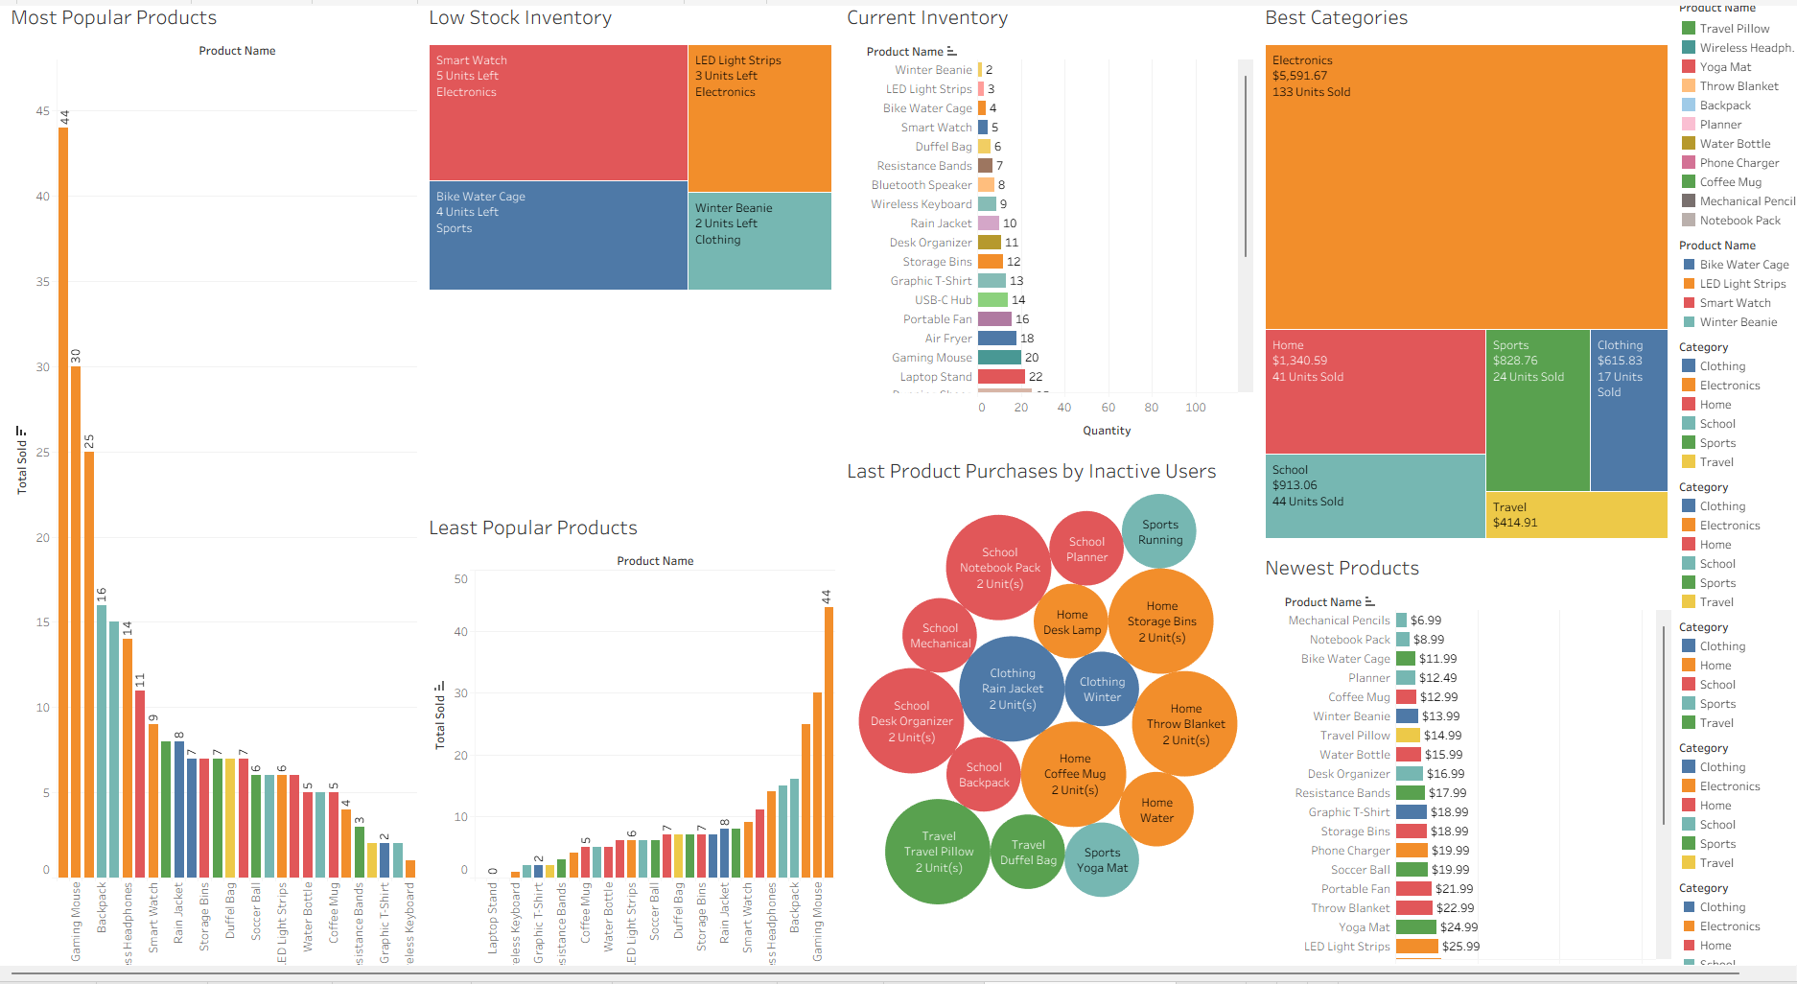
Tableau Visualizations in a Dashboard
Shows product sales and inventory status.
Highlights low-stock items
Compares category performance.

Slide 13
Demonstration of the Dashboard

Slide 14
Conclusion
This project showed the full database process: designing an ERD, building the database in SQL, adding sample data, running queries, and visualizing the results in Tableau into a Dashboard.
Overall:
The ERD was the plan
SQL was the build
Tableau was the visual summary
This concludes my presentation. Thank you for watching this presentation!

